Slide 1
ACE Walkthrough
We will cover the setup related to Institution in Card client

Slide 2
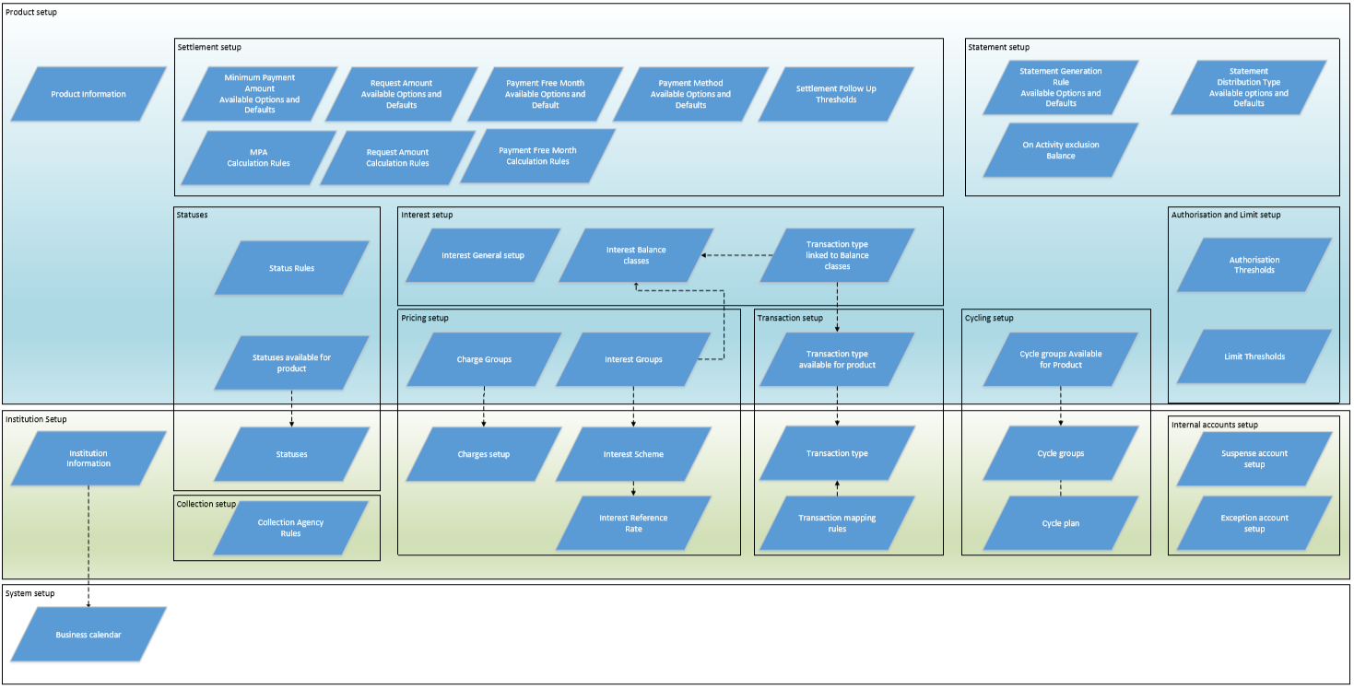
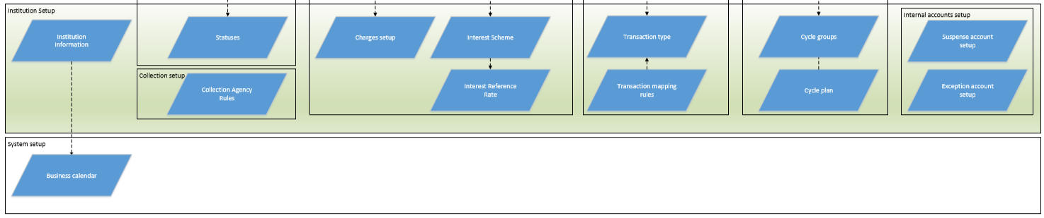
Ace Flow Diagram
In this session will be covered the part of the flow mentioned below:

Slide 3
About project ACE ( Accounts and Card Evolution)
Ace is all about to offer complete credit card services, to existing and new customers.
Our legacy card systems were CCL and FDKort, FdKort is still in function with some banks. It’s a mainframe based system and was having a lot of limitation to work, hence Evry decided to develop its own product .
Card team is divided in to ACE and Secana. Ace team manages card end to end lifecycle.Secana team is for Fraud Prevention.
In Ace Project, we work on development of Card Client

Slide 4
Ace Project flow coverage
System Setup | Module name | Performed Operations | Remarks | Functionality Related to the module
System level Setup | Business Calendar | Create, Maintain, Edit, Delete, View | We can set multiple banks at system level in card client and basic maintenance that we have access to is Business Calendar setup in the system. | Create Business Calendar Updating Non Business days and Weekends. Calendar complete Check Suspension and deletion of Business Calendar
Institution setup | Institution | Create, Maintain, Edit , Delete , View | In card client , we can create multiple institutes, this basically represents the bank setup and have all other required setup e.g. Charge, interest, products, cycle group…etc | Creation of Institution, by providing name and other details. Edit of institution information. Institution currency will be base currency. Allow account creation
Other setup to be done at Institution level
 | Statuses | Create, edit , Delete, Suspend, View | Account and payment status setup at institution level. Status name Status Key Processing Action | Account and payment status Status processing Action Write Off Account Restrict User Distribution type(Override Statement distribution type)

Slide 5
System Setup | Module name | Performed Operations | Remarks | Functionality Related to the module
 | Cycle Group | Setup of several cycle groups for one institution. Create , Edit, Delete, Suspension of cycle group | Cycle plan gets generated on creation of Cycle group . This will be editable and viewable | Cycle group name Frequency End of cycle date Day of the month Days before due date Number of business days Number of calendar days Days Holiday preference Payment due on Next end of cycle (Only if End of cycle is “Day of the month”) 2. X Days after end of cycle (Only if End of cycle is “Day of the month”) 3. X Day of the Month PDD Days PDD Calendar/Business day PDD Holiday Preference Grace days Grace day Calendar/Business day Grace day Holiday preference Cycle Group Key- Unique key Status
 | Cycle Plan | Cycle plan gets generated when a cycle group it gets attached to any card account product and account. | Once cycle plan is generated , user can modify it at account level. Any modification in cycle plan is applied in next cycle not in the current cycle. One card product can have multiple cycle group attached. One can be selected at account level. Once cycle plan is generated, cycle group can not be suspended.

Slide 6
System Setup | Module name | Performed Operations | Remarks | Functionality Related to the module
 | Charge Setup | Create,Delete , maintain, Edit of charges | Type of charges maintained at Institution level. Event based Periodic based Transaction Based | Charge Name Type of Charge Category Type: applied on Event based charges Statement distribution type( if event based charge category = Statement fee) Frequency Frequency: applied on periodic charges Charge collection : Advance/ Arrear, applied on periodic charges Prorated: Frequency other than Daily and weekly can be prorated. Applied on Periodic charges Defer Charge: Other than Event base Status fee charge, other charges are deferrable Number of days Defer to EOC Defer to last calendar day Defer to x days after event Waive first charge: Applied to periodic charges and event based charge – Statement fee, Anniversary fee Charge Transaction Type Status
Once charge record is created and Field Tiered = Yes | After creation of charge record we add price to it | Create, Edit, Delete | Adding price to the charge record | Record ID Effective Date Tiered- Yes/ No Low range/ High Range Price type= Amount/ Percentage(This is applicable for all types of charges. But for event based charge, it will always be a fixed amount. ) If percentage, Add base Minimum amount/ Maximum amount Different Tier range will get maintained

Slide 7
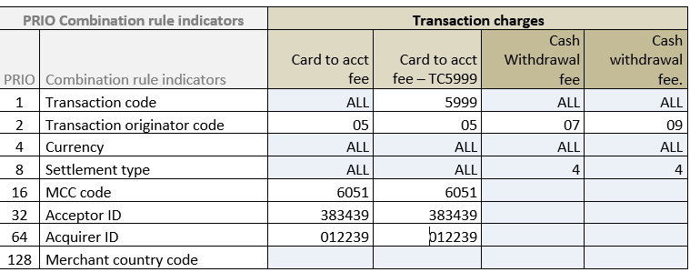
System Setup | Module name | Performed Operations | Remarks | Functionality Related to the module
Once charge record is created and Field Tiered = No | After creation of charge record we add price to it | Create, Edit, Delete | Adding price to the charge record | Record ID Effective Date Tiered- Yes/ No Price type= Amount/ Percentage(This is applicable for all types of charges. But for event based charge, it will always be a fixed amount. ) If percentage, Add base Minimum amount/ Maximum amount
Transaction Type charges | Creation of Transaction Charge, Trigger Rule, Prices |  | Example of Priority set up and Priority calculation: (For more details refer the requirement document | Name Type of Charge Charge Transaction type Transaction code Transaction code Originator Currency of the transaction Transaction Settlement type MCC Code Acceptor ID Acquirer ID Merchant Country Code Electronic commerce indicator Priority Status

Slide 8
System Setup | Module name | Performed Operations | Remarks | Functionality Related to the module
 | Interest Reference Rate | Create, Maintain, Edit, View, Suspend | Here we create Reference rate and first record. Threshold validation is applicable for price record. | Reference Rate Name Currency Threshold Setting up price Record Reference rate name Currency Threshold rate Status of Reference rate Effective date Rate
 | Interest Scheme Setup | Create , maintain , Cancel | Once reference rate is maintained , we create Interest scheme and first price record. Rate type- Fixed/ Floating Reference rate setup gets applicable if rate type is floating for any interest scheme | Interest scheme setup Scheme name Currency Calculation method Threshold rate Interest rate Future price record Effective date of interest rates Tier Setup/Type Fixed and Floating interest rates
 | Exception Account setup | Creation and maintenance of Exception account Create, edit, delete, View of Exception account | Create and maintain suspense account at institution level | 1. Account number (auto generated) 2. Account name 3. Category: Suspense , Write-off, Dispute 4.Balance-Sum of transaction amount , posted in account 5. Currency : any currency we can select , maintained at system level. 6.GL account 7. source- mandatory if category is suspense (e,g, Visa, Master. Multiple suspense accounts can maintained with unique combination of currency and source.

Slide 9
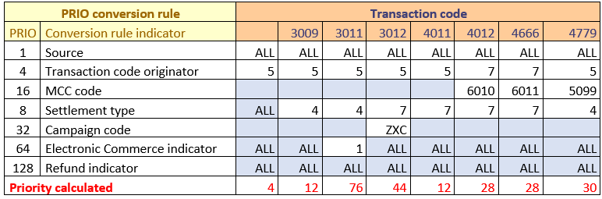
System Setup | Module name | Performed Operations | Remarks | Functionality Related to the module
 | Transaction Type | Create, edit , maintain, Delete the Transaction type | Define the rule to covert the file contains card transactions, into an internal file format | Transaction Code Category Transaction code narrative Transaction code description Debit Credit Status
 | Transaction Mapping Rules/ Conversion Rule | Create, Edit, Maintain, Delete | For each transaction type , it must be possible to define connection between distributor file to internal Ledger CAA file in card client | Source Transaction code originator MCC code Merchant Region Campaign code Electronic Commerce indicator Refund indicator Priority
Collection Setup | Collection Agency Rules | Create , delete, Edit, maintain, suspend | create, view, edit and delete of Collection agency rule. Collection agencies , comes in picture when there is payment due from the customer side or customer is defaulting the payments. Collection agencies are maintained at institution level. | Collection agency Name Distribution Rule Percentage Product Balance Country Country Default

Slide 10
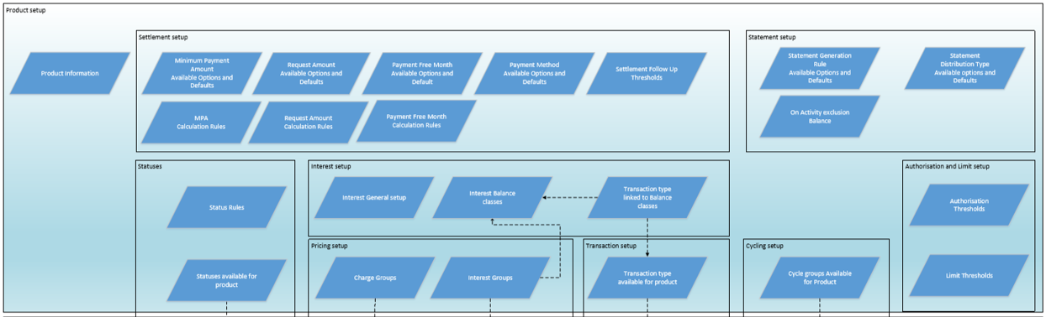
Product level setup in Card Client

Slide 11
System Setup | Module name | Performed Operations | Remarks | Functionality Related to the module
 | Card Product Creation | Create, Edit , Suspend | For creation of Card account product, go to institution and select module product. | Product Name Product Key Description Currency- This is amendable till product is inactive and no account created Status Card Program- Private, Business, Corporate Create accounts allowed- Yes/No Note : Even if the product is set up to not allow creation of accounts, the products and the existing accounts will still be processed as usual. However, new accounts cannot be setup for the product.
 | Product Statuses | View and delete | Here we link maintained Account and Payment statuses at Product level. | This for maintaining Account and payment statuses at product level. Name Default Account status Write-off account Note: Select Exception account number from the list available. Only if the processing action “Automated Write-off” is set to yes at institution for the account status linked to the product. Values: List contains all active write-off account from institution with currency compatible to the product. It must be possible to amend write-off account later. Validations for Status mapping at product level: For Delete: If the status is in use by account/s within the product (or) referenced to in the status rules group assigned to the product, system should present that the status cannot be deleted For set default: When default status flag is changed, all new accounts will directly have this set. The old accounts are not changed.

Slide 12
System Setup | Module name | Performed Operations | Remarks | Functionality Related to the module
 | Status Rule Creation | Here we create Status Rule at product level. Go to Institution > Product> Status Rule | These are the rules set up in order to make changes on the account by the system automatically. Each status rule is specifying the trigger of the change and which information that should be changed | Status Rule name Priority Only once per overdue period( Status fee) Interest Group Charge Group Fee
Interest | Interest Group Creation at product level | To create new interest group at product level | Balance Class: The purpose of the balance classes is to split the balance of the account on sub-balances (Classes) in order to assign different interest conditions. Posting of an amount to a balance class is depending on the transactions’ transaction code. Interest Group: The Interest Groups is used to provide different rates to different segments of accounts within a product. In the Interest group the Interest rate schemes is linked to the interest types and balance classes that are applicable for the product. It is possible to create several interest groups per product. | Interest Group Name Interest Scheme within limit-”Name”(Debit Balance interest Scheme) Interest Scheme Overdue Interest Scheme Over limit Interest Scheme Credit – “Name Default Cash Fees
Interest balance Classes | Go to Institution>Product> Interest | This describes the requirements for interest setup at product level | Setup general information for Interest payable and interest receivable per product. Setup debit balance classes. Create interest groups. Link the interest rate scheme to the interest group. Define setup for replenishment plan

Slide 13
Flow of interest setup at product level:

Slide 14
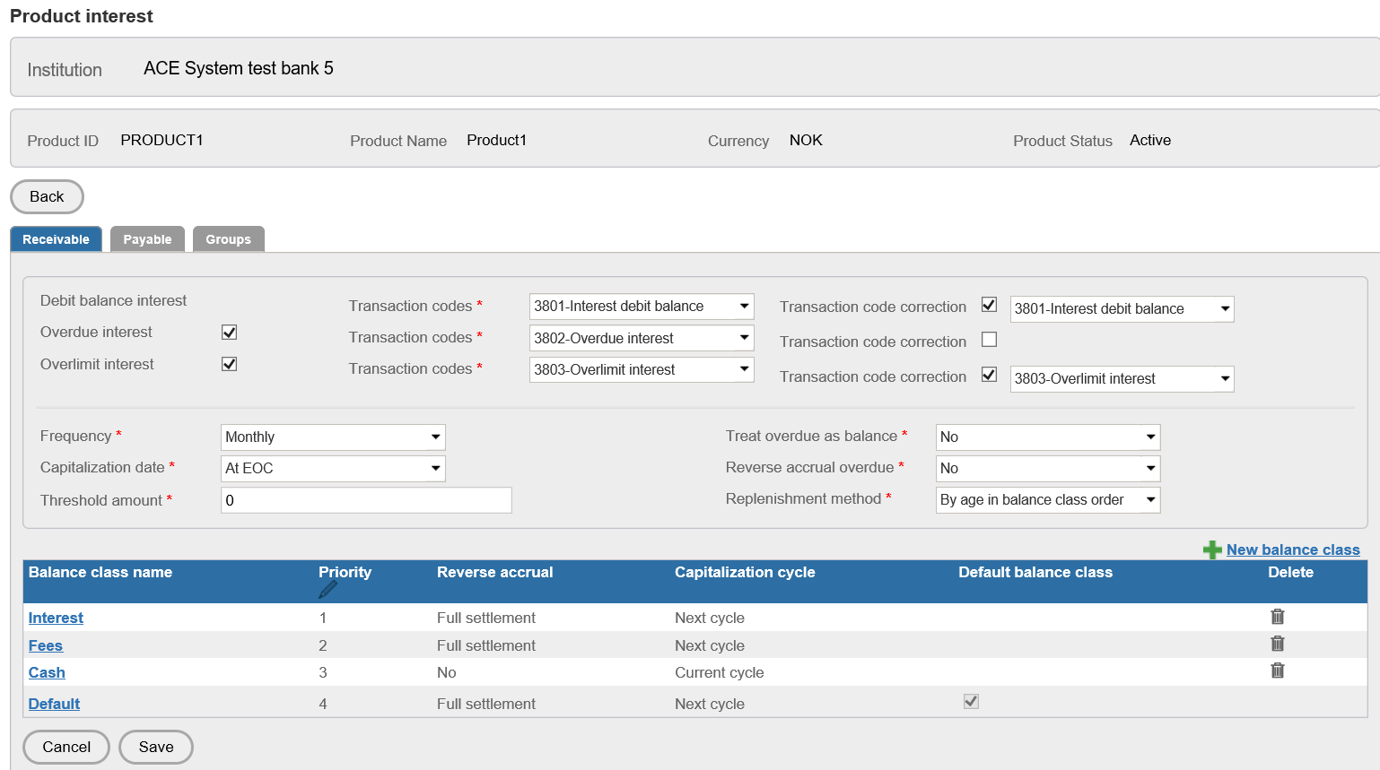

Slide 15
Interest Receivable/payable and interest groups with balance class at product level We calculate interest receivable on the debit balance in card account , this includes Debit balance, Overdue Balance, Overlimit balance
Field Name | Functionality
Debit Interest | This is outstanding balance of card account on this balance normal debit interest will be charged
Overdue Interest | This is the interest calculated on overdue amount. When customer does not pay on or before PDD, from that day system starts calculating Overdue interest.
Overlimit Interest | When user crosses assigned limit in the card account , then we charge overlimit interest on the extra limit uses.
Transaction Code | Different transaction code has been assigned in the system , for posting interest accrued on different balance.
Transaction code Correction | These transaction codes we setup for any interest posting correction. This is not mandatory setup, if no transaction code has been selected, then it means there will be no separate posting for the corrections
Frequency | Frequency for interest capitalization
Capitalization Day | This is the day of the interest capitalization. Possible value: Day Last calendar day Last business day (This is additional options available in card client, if “last calendar Day selected and “Holiday preference” = “Previous business day”) At EOC
Threshold Amount | This is the threshold for interest capitalization, if accrued interest is less than mentioned threshold ,than no capitalization will be performed for the account.
Treat Overdue as balance | If this flag is yes , system treats overdue balance also as outstanding balance and apply debit interest

Slide 16
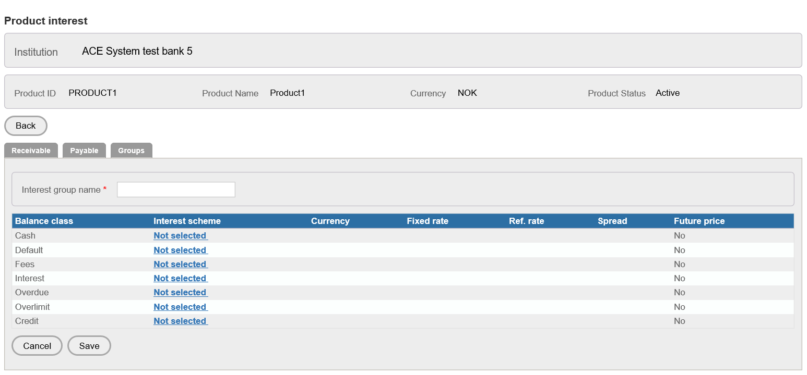
Field Name | Functionality
Reverse Accrual Overdue | IF this flag is checked , then once user makes the payment within grace days, then system reverse the accrual done on the overdue amount
Replenishment method | The replenishment is performed when the payment is received on the account. The process reduces the balances with the payment amount in the specified replenishment order. By Balance class order only By Age in balance class order
Balance Class
Balance Class name | This is the name of the balance class,it is amendable and unique. Changes should get updated online in all the screens.
Cycle capitalize interest | Current Cycle, Next Cycle. This setting futher follows the settings done for Capitalization date.
Reverse accrual | 1. No 2. On Full settlement 3. On full settlement if not rolled over. This setting further follow the setup done for Reverse accrual overdue field.
Transaction code | Here will select transaction codes , that will be available only for this balance class transactions.
Interest Group | The Interest Groups is used to provide different rates to different segments of accounts within a product. In the Interest group the Interest rate schemes is linked to the interest types and balance classes that are applicable for the product. It is possible to create several interest groups per product

Slide 17
System Setup | Module name | Performed Operations | Remarks | Functionality Related to the module
Charge Group | Charge group setup for product | View, create, edit and delete the setup | The Charge Groups is used to provide different charges and prices to different segments of accounts within a product. The charges setup at the institution level is linked to the Charge group. | It must be possible to create several charge groups per product. One of the charge group must be defined as a default
Cycle Group linking at product | Linking and delinking of cycle group at product level | Link cycle group at product level | Multiple cycle group can be linked at product level | Linking of cycle group to any product is possible only when cycle plan is generated for the cycle group

Slide 18
System Setup | Module name | Performed Operations | Field Name |  | Functionality Related to the module
Settlement | Minimum payment amount | The Minimum Payment Amount is the amount that is required to be paid at due date in order not to go delinquent. The calculation rules for how the Minimum Payment Amount should be calculated is done on the product where the same rules applies for all accounts within the product.
 |  |  | Minimum Payment Amount Options | Option for minimum payment amount calculation No minimum payment amount Fixed Percentage Outstanding balance | Option for minimum payment amount calculation No minimum payment amount Fixed Percentage Outstanding balance
 |  |  | Minimum payment amount default option | We select any of the option to get defaulted at account level | We select any of the option to get defaulted at account level
 |  |  | Lowest Fixed amount | Applicable if MPA is selected as Fixed | Applicable if MPA is selected as Fixed
 |  |  | Fixed amount default | Applicable if MPA is selected as Fixed | Applicable if MPA is selected as Fixed
 |  |  | Lowest Percentage | Applicable if MPA is selected as percentage | Applicable if MPA is selected as percentage
 |  |  | Percentage default | Applicable if MPA is selected as percentage | Applicable if MPA is selected as percentage
 |  |  | Lowest Minimum Payment Amount | Applicable if MPA is selected as percentage. This gets applicable if calculated MPA is very less, than this amount gets applicable | Applicable if MPA is selected as percentage. This gets applicable if calculated MPA is very less, than this amount gets applicable
 |  |  | Lowest Minimum Payment Amount Default | Applicable if MPA is selected as percentage. This gets applicable if calculated MPA is very less, than this amount gets applicable | Applicable if MPA is selected as percentage. This gets applicable if calculated MPA is very less, than this amount gets applicable
Calculation rules for Minimum Payment Amount

Slide 19
Module | Field name | Field Details | FuncNOtionality Related to the module
Settlement- MPA | Percentage calculation option | Option are Up to Limit On Account balance | For example: Account balance is 1100 and Limit is 1000. If ‘Up to limit’ it means that the percentage will be calculated on 1000. If ‘Account balance’ it means that the percentage will be calculated on 1100. Account balance is 900 and Limit is 1000. If ‘Up to limit’ it means that the percentage will be calculated on 900. If ‘Account balance’ it means that the percentage will be calculated on 900.
 | Exclude Overdue amount | Options are Yes NO | To select if the overdue amount should be excluded in the % calculation.
 | Add full Over limit amount | Options are Yes NO | To add Overlimit amount in the percentage calculation. For example: Account balance is 1100 and Limit is 1000. If ‘Yes’ it means that the 100 will be added into the calculated minimum payment amount
 | TX included in full |  | Here we can select some transaction codes, which will gets excluded from the % calculation for MPA and will be added in Full. For example, if transaction type for Overdue interest is selected. If the balance is 1000, the sum of the Overdue interest within the cycle is 10 and the minimum payment amount percentage is set to 10%. Then the calculation will be 10% of 990 (1000 – 10) plus 10, i.e. 109. The calculation will be described in the processing requirements.
 | Rounding Rule | No UP Down Nearest | For rounding up the calculated MPA
 | Rounding unit |  | this is the unit , until rounding can be performed
 | Account balance threshold |  | To setup the threshold for calculating MPA if account debit balance is less than the set threshold than no MPA will get calculated.

Slide 20
Module | Field name | Field Details | FuncNOtionality Related to the module
Request amount | The amount that is requested to be paid though there is no follow up on whether the amount has been paid or not. The Request amount can never be less than the Minimum Payment Amount.
 | list of options: Fixed Outstanding Balance Minimum Payment Amount
 | Request amount default | Defaulted option for Request amount | This amount will get defaulted at Account level
 | Lowest Fixed amount | Applicable when option selected as Fixed amount
 | Fixed amount default | Applicable for option Fixed amount
 | Allow fixed amount for credit balance | This is used to calculate Request amount when option selected as Fixed | Calculation rule for Fixed: It will be the fixed or the Minimum payment amount, whichever is greater. If allow fixed amount for credit balance is set to No, then if the closing balance on the statement of account is less than the fixed amount, the lesser amount will be debited
 | Request condition | Request only if minimum payment amount is required. (default) Always request except when PFM. Always request.
Payment Method | The payment methods are the methods of defining, how the amount will be transferred in to the system. The available options for this parameter are set up for the product. It can for example be ‘Paid by Account holder’, ‘Avtalegiro’ or ‘Direct Debit’
 | Payment Method options | Pay by invoice, Autogiro/Avtalegiro, Direct debit.
 | Payment Method default | One method should be default
 | Restrict user | To restrict user to set the payment method manually for the account

Slide 21
Module | Field name | Field Details | FuncNOtionality Related to the moduleap
Payment Followup Threshold | The Payment Follow up Thresholds are parameters that indicates how large discrepancy that is allowed between the Minimum Payment Amount and what was actually paid.
 | Full payment of total outstanding threshold | When user is making payment before due date and before end of grace days, and if paid amount is not covering the closing balance fully , than we check the difference between paid amount and this and closing amount is less than the mentioned threshold than we consider the payment as full payment
 | Full payment of Minimum payment amount Threshold option | When user makes payment before ending of grace days and the difference of paid the mentioned threshold . Then system consider the payment as full MPA payment. | No overdue amount Up to end of grace days Independent of overdue amount Up to end of grace days No overdue amount Always: amount and MPA is less than Independent of overdue amount Always
 | Full payment of Minimum payment amount Threshold | It must be possible to set up threshold for when the payment amount before the end of grace days is considered to have covered the Total minimum payment amount. It is an amount field.

Slide 22
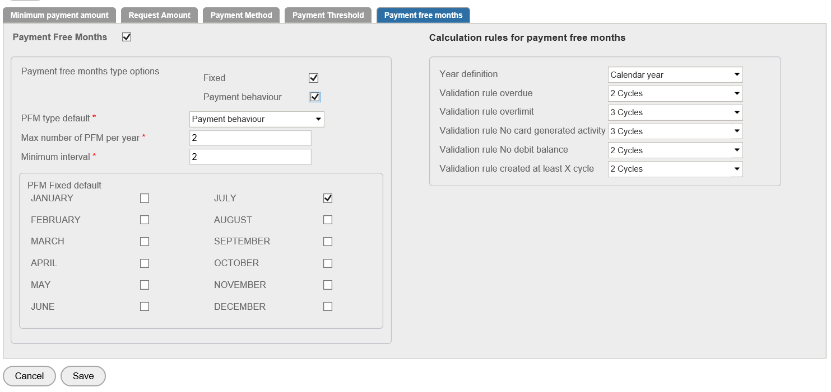
Payment Free Month

Slide 23
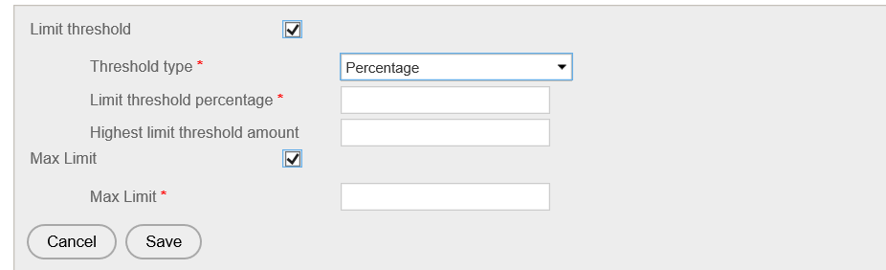
LIMIT | The Limit parameters includes the Over limit threshold, in percentage of the limit, or amount or the combination (percentage but maximum the amount). It ensures that over limit charges and interest is not calculated for when the limit is breached for small amounts.

Slide 24
Module | Field name | Field Details | FuncNOtionality Related to the moduleap
Transaction type | Transaction type maintenance at product level |  | To add Transaction code with View/Edit/Suspend as alternative flow and exception to cancel.
 |  | Value date | This field is used to provide value date for each transaction code. It is a drop down field and only one option can be selected. Possible values: EOC date Payment Due date Book date Transaction date X days after transaction date X days before book date X days after book date X days before EOC date X days after EOC date X days before payment due date X days after payment due date
 |  | Value date reversal | This field is used to provide value date reversal for the each transaction code. This value date reversal will be applied when particular transaction is reversed. It is a drop down field and only one option can be selected. Possible values: EOC date Payment Due date Book date Transaction date X days after transaction date X days before book date X days after book date X days before EOC date X days after EOC date X days before payment due date X days after payment due date

Slide 25
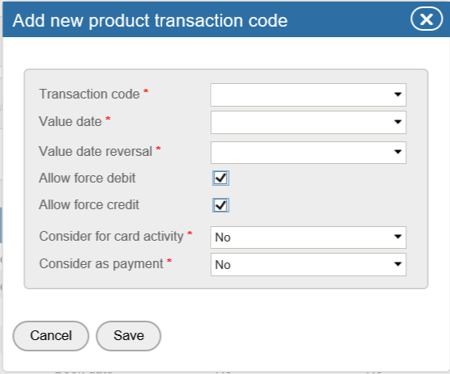

Slide 26
Card account creation
Billing Account | This account is use to calculate the interest. This is the account which is invoiced. Sum of supplementary account transactions , is displayed in Billing account.
Supplementary account | purpose of the Supplementary accounts is to be able to distribute a part of the billing account’s limit to another Cardholder. This is shadow account All transaction of supplementary account are copied real time in Billing account in order to follow the

